Slide 1

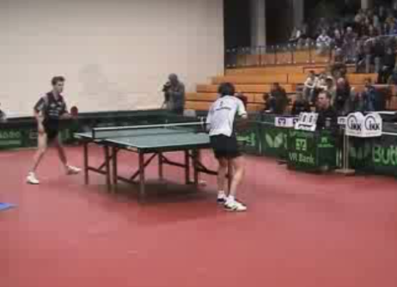

DIGITAL SIGNAL PROCESSING Chapter 9 MULTIMEDIA SIGNAL PROCESSING (Data Compression)
EEE DSP Teaching Team
Notes:
This chapter introduce you to Multimedia signal processing in particular data compression
In previous chapter, we cover
the sampling theorem.
how undersampling leads to aliasing distortions.
Explain the sampling process in frequency domain.
the tradeoffs involved in the selection of sampling frequency
how an analog voltage may be represented by binary codes by quantization.
In fact, these concepts are also applied for this chapter
One of the main argument is why data compression? Data compression takes time and could slow down my computer. What are really the advantages of going through data compression algorithms or methods? Does it make a big different?
Data Compression is built on mathematics and you will learn a few techniques on how to do data compression. Two simple ideas are to reduce the number of unique symbols in the data and encode more frequent symbols with fewer bits.
We will cover a bit more later

Slide 2
Understand the fundamental principles and techniques in multimedia signal processing and compression
At the end of this chapter, students should:
Explain what is data compression and the different components of multimedia signal and the need for data compression.
Define lossless and lossy compressions/methods and the different classification of lossless classifications.
Understand the constraints of multimedia on internet, wireless communication, and storage media like DVD and the different image and video formats.
Know the different standards for the image and video compression, and their compressions.
Notes:
This chapter will help you to understand the fundamental principles and techniques in multimedia signal processing and compression
Explain what is data compression and the different components of multimedia signal and the need for compression.
Define lossless and lossy compressions/methods and the different classification of lossless classifications.
Understand the constraints of multimedia on internet, wireless communication, and storage media like, DVD and the different image and video formats.
Know the different standards for the image and video compression, and their compressions.

Slide 3
Topic 1
What is data compression and the different components of multimedia signal and the need for data compression?
Notes:
When data are processed, interpreted, organized, structured or presented so as to make them meaningful or useful, they are called information. Information provides context for data.
For example, a list of dates — data — is meaningless without the information that makes the dates relevant (dates of holiday).
For the first topic, we are going to look into what is data compression.
Data compression is about storing and sending a smaller number of bits.
And the need for data compression.
All these are very useful as we are using more and more digital devices and digital transformation in our work.
For example, in the past we use film camera, moving to analog camera and then now digital camera. Not only digital cameras are used to take photo shots but use as a video recorder. During the covid 19 situation, where the assessment for mid semester test, where the students are sending photos of their results online. Hence there is great important in this area.

Slide 4
Different components of multimedia
Multimedia can be any combination of different content forms:
Text – Unformatted, formatted, hypertext (eg. HTML)
Audio – low-fidelity speech in telephony, and high-fidelity stereophonic music
Images - computer-generated images and digitized images
Video – video clips, movies
Notes:
In the actual world, the information is analog such as our voice.
The information must first be converted into digital form.
It will go through the standard processing of sampling, quantization and encoding as covered in the first few chapters of this module.
Sampling Theorem and Nyquist criteria play a very important part of digitization.
Before we go into the different components of multimedia signals, we will have to understand what is Multimedia?
You can find the meaning of multimedia from different sources online sources.
According to Wikipedia, Multimedia is media that uses multiple forms of information content and information processing (e.g. text, audio, graphics, animation, video, interactivity) to inform or entertain the (user) audience.
In Engineering, multimedia is signals which are function of time and or space.
Multimedia can be text, art, sound, animation, and video.
Multi – Many
Media – any forms such as text, audio, images, animations, video etc. It can refer to any hardware or software.
Video and Audio files are very large.
Text - unformatted text as strings of characters from a limited character set - notepad, formatted text
strings as used for the structuring – Microsoft word
Audio signals are analog in nature and is determined by frequency (pitch) and amplitude (loudness). For storage, like the rest, it need to be converted to digital representation and go through the standard method of sampling, quantization and coding.
Images are computer-generated images and digitized images
Video are video clips, movies

Slide 5
Multimedia signal processing supports multimedia applications
Data Compression
Data and file format
Multimedia input, output and storage
Notes:
Multimedia signal processing supports multimedia application for the data compression, different data and file format, multimedia input, output and storage
To do data compression, it will increase information processing power, which can also be expensive.
However there is also saving in the storage and transmission time.
If compression and decompression are done in I/O processor, less time is required to move data to or from storage subsystem, freeing I/O bus for other work. In sending data over communication line: less time to transmit and less storage to host.

Slide 6
“Digital” World
Explosive Digital DATA!
Uncompressed video >20 Mbytes just for 1s
How about biomedical images with higher-resolutions
Internet of Things, Satellite Imagery, Geographical Information Systems, Wireless Sensor Networks, Virtual Reality
Mobile communications
Notes:
The digital revolution occurs when the masses started to own their digital cameras and computers in the 80s and when internet came along in the 90s, the digital world takes shape.
Huge digital data were produced required larger and large amount of storage. The floppy disks gave way to hard disks. There is huge demand for biomedical and satellite fields.
Video recorders also came along where uncompressed video for 1 second takes up more than 20 Mega bytes of storage.
The late 1990s saw a massive growth in the number of mobile phone users across the developed world. By the year 2000 there were over 500 million users in Europe alone. What was totally unexpected was the massive growth in the market for mobile multimedia around 2000 created by the second generation, 2G cellular networks, wireless LANs and digital broadcast systems followed by Third Generation Mobile Systems. And now we are going into 5G mobile communication!

Slide 7
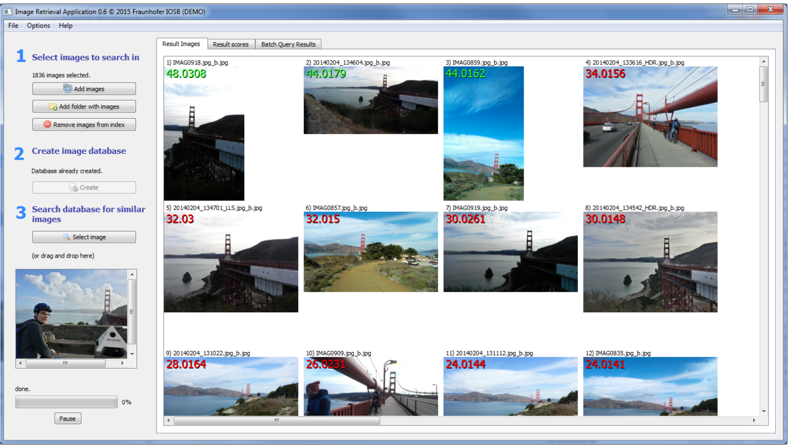
Content based image retrieval
@Fraunhofer-Institute IOSB
Notes:
Fraunhofer-Institute IOSB develops a software module for content based image retrieval which the demonstration software can be obtained at Given an input image, the aim of the software is to find those images within an image database which show the same object or scene as the input image. With such enormous amount of images to be stored and retrieved, the compression technology is critical to keep the size of the images small and also fast retrieval.
We can start to see the multimedia application in this area where security check and matching applications. The size of the data becomes critical and it will also affect the speed of service.

Slide 8
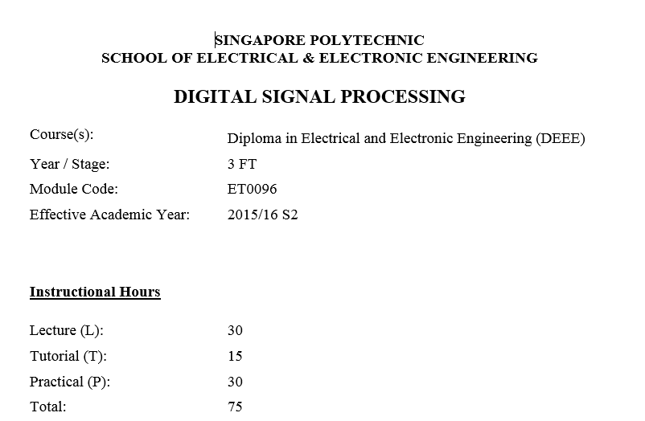
TEXT
Notes:
Text can be created in word or in notepad.
There are different classifications of text
Unformatted text, formatted text and hypertext
Unformatted text is plain text.
For formatted text, it has more “enriched” features – fonts, sizes, shapes
Plain text can be 1to 40 kilobytes depending using notepad or Microsoft word applications.
If the text document includes images that it can go up to hundreds of kilobytes

Slide 9
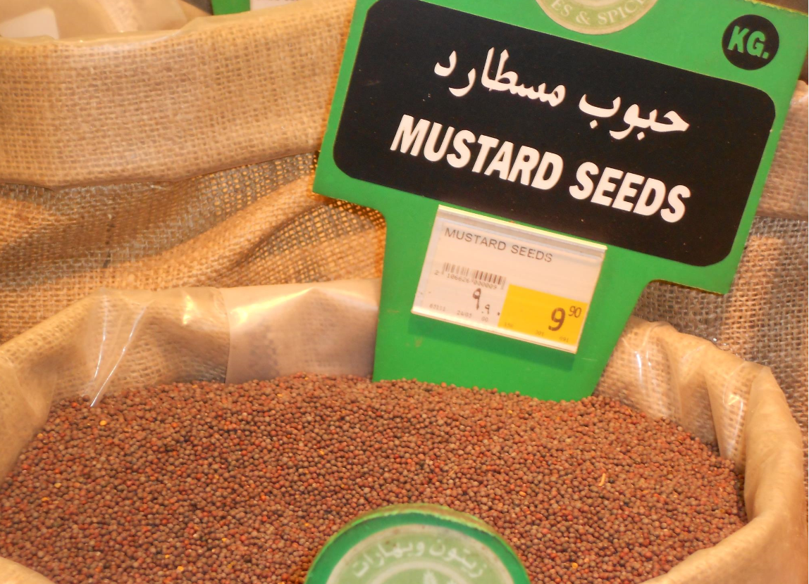
IMAGE
Color image ~80Mb
Notes:
We can see most of our images comes from our cameras!
An image may be considered as a two dimensional signal function with real coordinates x and y.
Using sensors and other image acquisition equipment to obtain the brightness or intensity of the light of an image for the value where x and y denotes the spatial coordinates .
Resolution is the number of pixels spread across a display and is usually written in the form of horizontal pixels x vertical pixels, such as 1920 x 1080.
Images involving only intensity are called grey-scale images.
If it is colour image, the size will be much larger

Slide 10
Image
Computer generated or digitized document, BITMAP or VECTOR graphics.
Computer generated – Bit-map form, GIF(graphical interchange format), TIFF (tagged image file format) etc.
Digital document – Fax machine! (Single bit, 1 for black , 0 for white ), Black and white picture (8 bits per picture element – 2^8 = 256 different levels of gray per element).
In general, a bitmap graphic is much larger than a similar vector graphic.
Notes:
Computers generate a lot of digitized documents.
Two types – bitmap graphics and vector graphics.
A bitmap or “raster” graphic is a picture stored as a set of pixels created from rows of different coloured pixels that together form an image that correspond to the grid of dots on a computer screen.
In their simplest form, bitmaps have only two colours, with each pixel being either black or white. Digital document – Fax machine! (Single bit, 1 for black , 0 for white ), Black and white picture (8 bits per picture element – 2^8 = 256 different levels of gray per element).
Some examples of bitmap graphic formats include GIF, JPEG, PNG, TIFF, XBM, BMP, and PCX. The image displayed on a computer monitor is also a bitmap, as are the outputs of printers, scanners, and similar devices. They are created using paint programs like Adobe Photoshop which many of you are familiar with.
Vector (also known as "object-oriented") graphics are constructed using mathematical formulas describing shapes, colors, and placement. Some of vector graphic formats are PICT, EPS, and WMF as well as PostScript and TrueType fonts. These are created with GIS and CAD applications as well as drawing programs like FreeHand, Inventor and Autodesk.
The rest of the slides will be referring to Bitmap.

Slide 11
Terms
Bpp or bits per pixel - the number of bits per pixel.
Color images are usually of the 24 bpp (16777216 colors) format, or 16 bpp(65536 colors).
The size of an image depends upon three things.
Number of rows
Number of columns
Number of bits per pixel
Size of an image = rows * cols * bpp
Notes:
Binary image – each pixel is represented by using one bit
Computer graphics – four bits per pixel are used
Grayscale image – eight bits per pixel are used
Colour image – each pixel is represented by using 24 or 32 bits

Slide 12
Images
Make of rectangular array of dots called Pixels (picture elements).
m x n – m rows and n columns.
Pixel values may be grayscale or colour.
Grayscale usually has a range of 0 (no light intensity) to 255(fully white). Each pixel takes 1 byte.
Colour image - true colour form. one byte for each of red, green and blue. One pixel requires 3 bytes of memory and 16,777,216 (2^24) possible colours.
A 1-bit monochrome image contains no color.
Notes:
An image is just a collection of color dots (pixels) arranged in rectangular array .
Matlab represents images in several way such as m rows and n columns.
For 3 dimensional array of values where the number of rows and columns match the image's resolution (height and width). The third dimension of the array contains 3 values representing the red, green, and blue color levels as numbers.
If the image matrix is defined as a uint8 type, the numbers range from 0 to 255, where 0 is no light intensity and 255 is full intensity for grayscale.

Slide 13
Example
Given a gray scale image,1024 X1024 columns has 256 different shades of gray or 8 bits per pixel.
Size of an image = rows x cols x bpp
= 1024 x 1024 x 8 bits
= 1 Mbytes
Pixel size is the distance between the dots in the device monitor. It is also known as dot pitch. Pixel density is the number of pixels per unit length in the device monitor.
Notes:
Given a gray scale image,1024 X1024 columns has 256 different shades of gray or 8 bits per pixel.
We can calculate the size of the image to be about 1 mega bytes.
Note that Pixel size is the distance between the dots in the device monitor. It is also known as dot pitch. Pixel density is the number of pixels per unit length in the device monitor.

Slide 14
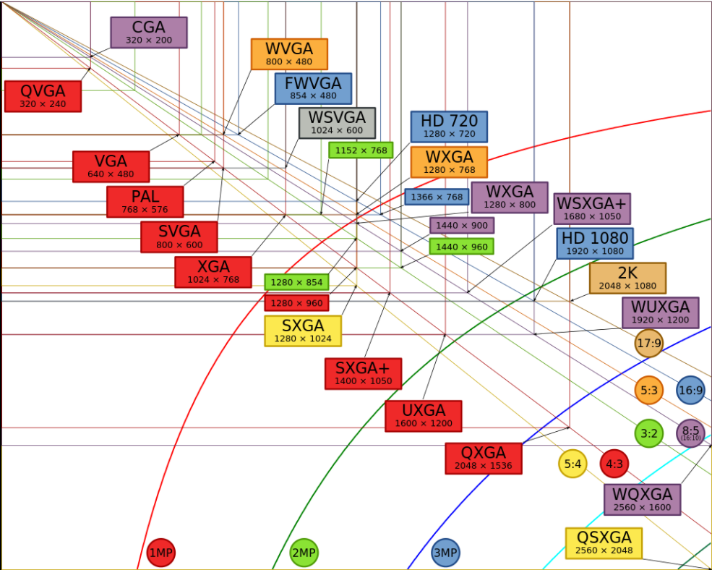
Display Resolution
https://en.wikipedia.org/wiki/Graphics_display_resolution

Slide 15
Display Resolution
Common image format or resolution: VGA, XGA,SVGA…QUXGA
Example
The size of each XGA image in bits is
1024x768 pixels per frame x 24 bits per pixel
=2.25 Mbyte
What is the time to transmit with a speed of 1.5Mbps modem?
Time = 2.25 x 8 Mbits/1.5 x 10⁶ = 5.3 s
Constraints of multimedia on internet, wireless communication, and storage media like, DVD and others if large amount of data is going to be sent through the network.
*https://en.wikipedia.org/wiki/Graphics_display_resolution
Notes:
For image XGA type, if the pixels per frame is 1024 x 768 and the bits per pixel is 24, multiplying both, you will get 2.25 mega bytes of uncompressed size
To transmit this image over a 1.5 Mega bit per second modem, it will take

Slide 16
Example
Calculate the size of the image in Mbytes , with resolution of 280x1024 where each pixel of an image is coded with 24 bits.
Solution
1280x1024x24/(1024 x 1024) = 30Mbits
30 Mbits/8 = 3.75 Mbytes
Notes:
Given an image of 280x1024 pixels per frame and 24 bits per pixel, calculate the size of the image.
280 multiply by 1024 multiply by 24 and divided by 1024 to convert to kilo and 1024 to mega and 8 to bytes.
The total image size is 3.75 mega bytes

Slide 17
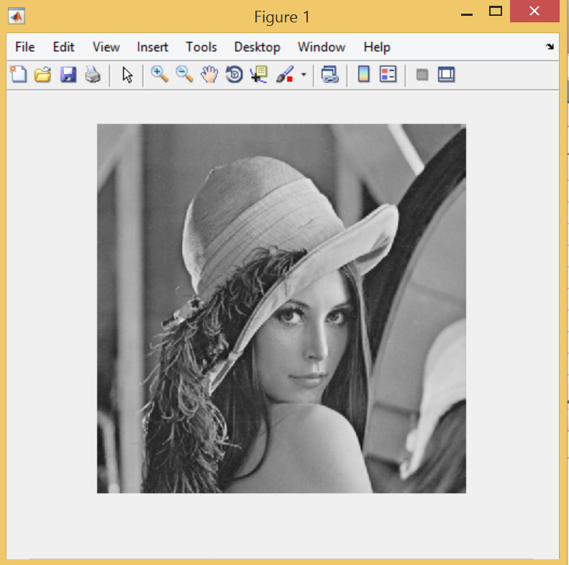
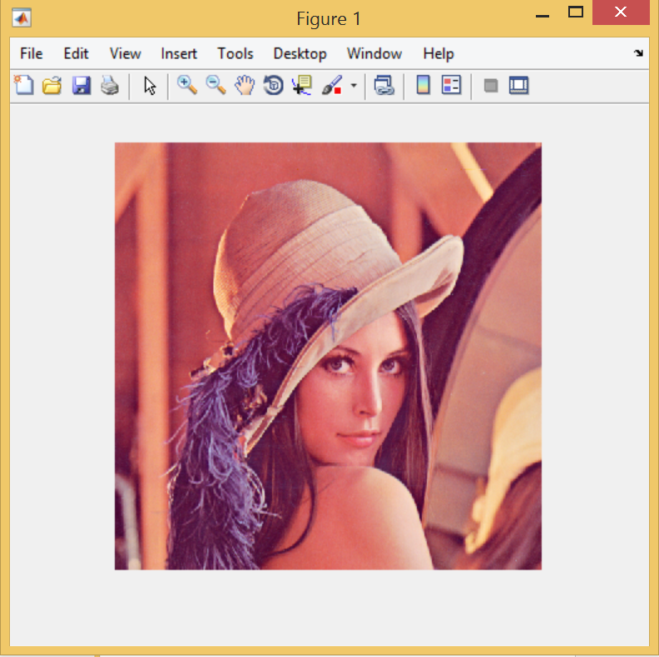
Lena512 displayed by Matlab
>> I=imread('lenna_grey_512.bmp');
>> imshow(I)
>> I1=imread('lena_color.tiff');
>> imshow(I1)
Notes:
Image I1 is the color image. Have 3 bytes for colour. Storage size is 3x than black and white.
Many 24-bit color images are actually stored as 32-bit images, with the extra byte of data for each pixel used to store an alpha value representing special effect information (e.g., transparency).
The file size for colour picture will be much higher
Note the different file extension

Slide 18
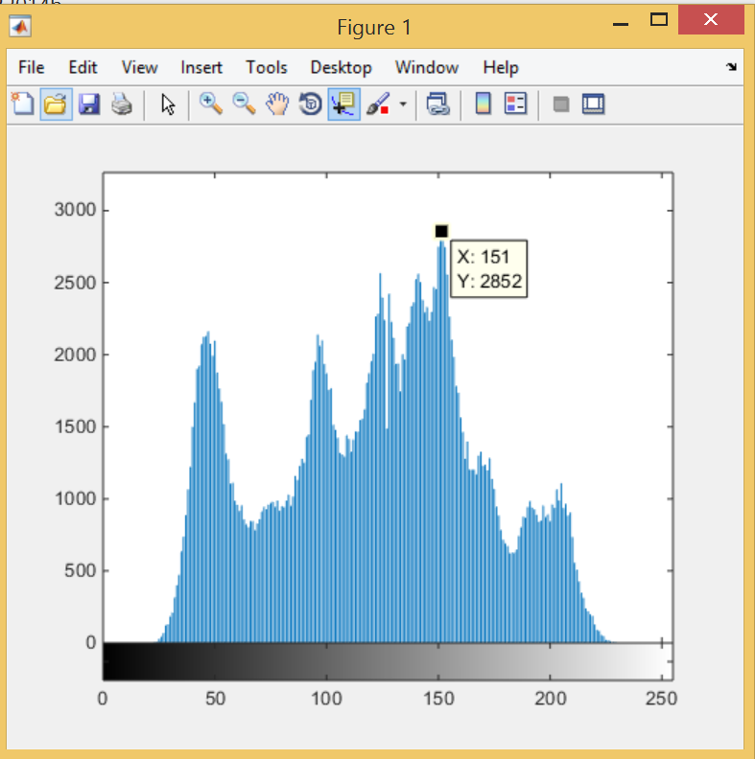
Histogram of Image I, grey-scale
>> imhist(I)
Notes:
You can refer to pages 114 to 119 of the textbook for some Matlab image commands in procedure 2: image processing applications, pages 114 to 119.
Matlab command imhist creates an image histogram which is a chart that shows the distribution of intensities in an indexed or grayscale image. The imhist function creates a histogram plot by defining n equally spaced bins, each representing a range of data values, and then calculating the number of pixels within each range.

Slide 19
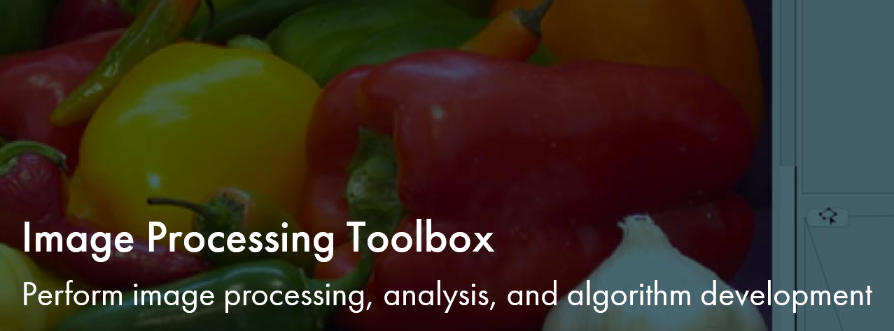
Matlab Image Processing Toolbox
https://www.mathworks.com/videos/image-processing-toolbox-overview-61214.html
Notes:
You may like to go through the 2 minutes video on Matlab Image Processing Toolbox

Slide 20
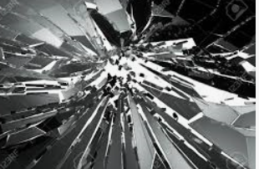
AUDIO
100 min dig audio
~ 1Gb
Speech audio: 16000 samples/second
Music: 44100 samples/second
Notes:
Two properties of audio – pitch (shrillness of sound, frequency and loudness (amplitude)
Digital audio – how many bits quantizer? Higher numbers of quantization level – lower distortion
This is covered in the previous chapter under quantization and some information in the recommended textbook

Slide 21
Audio
Two common types of audio signals: our regular speech signals and music-quality audio.
Depending on the quality the transducer(or microphone and recording environment), the quality is very much determined through the digitization of the speech and music. This is in synthesized format audio.
Bandwidth of a typical speech signal – 50 Hz to 10kHz and music signal – 15kHz to 20 kHz.
Normal speech – 12 bits per sample, music – 16 bits per sample
Stereo (music stereophonic sound) bit rate is double of mono signal.
Digital audio – popular formats: wav and mp3
Notes:
Digital audio has many formats – au, wav and mp3 format. Note that au and wave formats store audio in the uncompressed form.
MP3, a popular format, compresses audio using Layer 3 of the MPEG-1 audio compression standard.
audio is a 1 dimensional vector unlike image – 2 dimensional and video – 3 dimensional vector

Slide 22
Example
A music signal has the bandwidth from 15Hz to 20kHz, based on 12 bits per sample for the music signal, what is the minimum bit rate for the music signal and the memory required to store a 30 minutes of the music.
Solution
*Nyquist rate = 2 x 20 kHz = 40kHz or 40ksamples per sec
Bit rate generated = 2 x 40k x 16 = 1280 kbps (stereo)
Memory required = (1280 x1000x30x60)/8
= 288Mbytes!
* See page 17 of Digital Signal Processing Basics by Patrick Chow/M.Fikret Ercan,5th edition
Notes:
Audio CDs can record up to 75 minutes of high-fidelity recorded sound. The sampling rate is 44,100 samples per second, which is fast enough to record any sound audible to humans. Each sample takes up to 16 bits, producing quite a wide dynamic range to distinguish between aa quiet whisper or a loud scream.
The above calculation shows that the huge memory size required such to record 30 minutes of music.

Slide 23
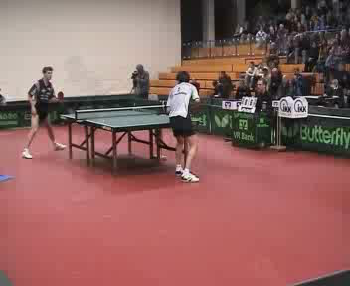
Video
1-hr size of Uncompressed DVD Movie = (720 x 576) pixels x 3 bytes x 25 fps x 60 sec/min x 60 min = 104.3 GB
Video ~100MB to GB
Animation =~Gb
Notes:
Video is basically make up a sequence of continuously varying pictures. Each picture in the sequence is also known as a frame.
In order to see pictures continuously without suffering from intermittent problem, 25 or more frames per second must be displayed. There are many video standards and an 1 hour video of uncompressed video can be very large if uncompressed.
Some of the important parameters are width in pixels, heights in pixel, color depth and frames per second besides scanning method (interlaced or progressive)
The width, height and colour depth dictate how much information you have to deal with per frame.

Slide 24
Frame rate in video
Frame rate refers to the rate at which video images are acquired and processed or the rate at which the images are transferred from the system to the display. The international standard for frame rate is 25 frames per second and in the US it is 30 frames per second (fps).
Notes:
Frame rate is the amount of individual video frames at which video images or cameras are acquired and processed or the rate at which the images are transferred from the system to the display.
Frame rate comes in a few different standards (expressed as frames per second or fps such as 24fps, 25fps, 30fps, 60fps, and 120fps
Standard conventional frame rates are 25 fps for PAL, 30 fps for NTSC), and 24 fps for cinema films. High-resolution (HD) videos of 1080x1920 pixels per frame can be up to 60 frames per second (fps)
Why 24 frames per second? This is the threshold beneath which you would notice flicker or jerkiness on the screen

Slide 25
Need/Purpose of Data Compression
Reduce storage size
Save transmission bandwidth
Save cost by reducing the transmission time
Notes:
Compression: the process of coding that will effectively reduce the total number of bits needed to represent certain information.
Data compression condenses large files into much smaller ones. It does this by getting rid of data that isn’t needed while retaining the information in the file.
Or Data compression means sending or storing a smaller number of bits ie there are some savings in the number of storage size.
Or Data compression is the process of encoding information using fewer bits or other information-bearing units.
Bandwidth are limited resources and not cheap. Storage can be enormous for uncompressed data especially video which can run into hundreds of megabytes

Slide 26
Image data compression eliminates redundancy and irrelevancy
Temporal - Pixels in two video frames that have the same values in the same location.
Spatial - correlation between neighboring pixels or data items.
Spectral - correlation between color or luminescence components. This uses the frequency domain to exploit relationships between frequencies of change in data.
Psycho-visual - exploit perceptual properties of the human visual system.
Notes:
Redundancy refers to the amount of wasted space consumed by storage media to record picture information in a digital image.
Image compression is achieved by exploiting redundancies in the image. These redundancies could be spatial, spectral, or temporal redundancy.
Spatial redundancy: elements that are duplicated within a structure, such as neighboring pixels in a still image. Exploiting spatial redundancy is how compression is performed.
Spectral redundancy is due to correlation between different color planes.
Temporal redundancy: pixels in two video frames that have the same values in the same location. It is due to correlation between different frames in a sequence of images such as in videoconferencing applications in broadcast images. Exploiting temporal redundancy is one of the primary techniques in video compression.

Slide 27
Data Compression Scheme
Input Data
Output Data
Compression
(Encoder)
Decompression
(Decoder)
Storage Device or Channel
Coder + Decoder = CODEC
Notes:
The name codec actually comes from a merging of these two concepts into a single word: enCOder and DECoder.
Traditionally, CODECs means Coders and Decoders together and the codec performs the Analog to digital conversion and decoder performs the decoder to analog conversion.
Video codecs are video compression standards done through software or hardware applications. Each codec is comprised of an encoder, to compress the video, and a decoder, to recreate an approximate of the video for playback.

Slide 28
Data Compression Process
Uncompressed
Data
Compressed
Data
Coding Steps
Figure 9.1 Data Compression Process
Compression ratio, Cr =size of data before compression
/size of data after compression
Relative Data Redundancy, Rd = 1 - 1/Cr
Notes:
Data compression is a process in which the size of a file is reduced using fewer bits of storage than the original file.
A fundamental component of data compression is that the original file can be transferred or stored, recreated, and then used later (with a process called decompression).
The uncompressed data go through the coding steps, or algorithm and the output will be a much smaller file size than the original file.
The easiest way to measure the effect of a compression is to use the compression ratio.
Compression ratio, Cr is defined as the ration between the size of data before compression over after compression.
The larger the compression ratio, the better is the compression method. If the value is 1, there is literally no compression at ALL.
Relative Data Redundacy, Rd is defined as 1 – 1 over Cr.
If Cr is 1, no data compression benefit, then relative data redundancy Rd is zero.

Slide 29
Quality | Size | Compression Ratio
Raw Lena_Color.TIFF | 769KB | 1:1
7_zip TIFF | 620KB | 1.2:1
Q=100 | 225KB | 3.5:1
Q=75 | 37KB | 17:1
Q=50 | 24KB | 27:1
Q=10 | 16KB | 72:1
Notes:
Image compression is a tradeoff between visual quality and the compression ratio, or size of the output data.
The tradeoff also depends on the image content.
Matlab has features to set the quality factor for different desired compression ratio. The lower the quality factor, the higher the compression ratio as shown in the table.
You will try this out in the data compression lab session.

Slide 30
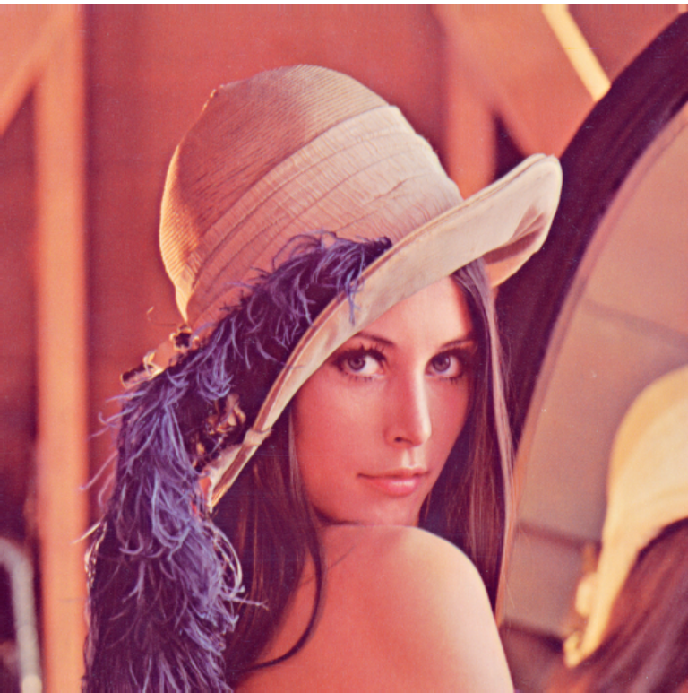
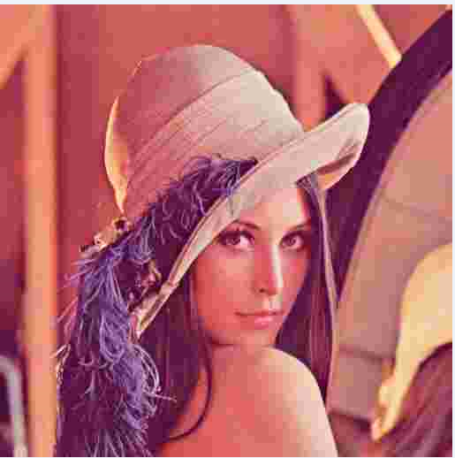
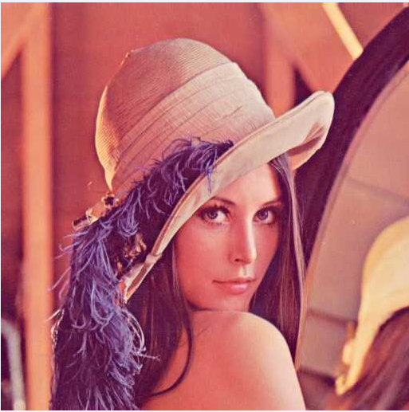

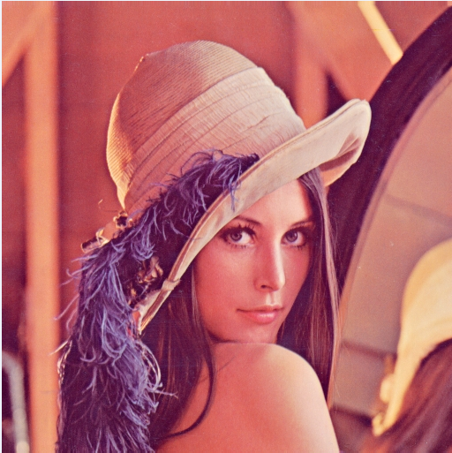
Original Image | Quality, 10 | Quality, 50 | Quality, 75 | Quality, 100
769 kB | 10 kB | 23.7 kB | 36.9 kB | 224 kB
CR= 1:1 | 76.9 | 32.45 | 20.84 | 3.43
Notes:
You can see that the compression ratio, CR get bigger, the size of the compressed pictures get smaller
For CR=1 not compression at all, the picture size is 769 kilo bytes
And CR=76.9, the size compressed picture size is 10 kilo bytes. Using human eyes, we cannot really tell the difference.

Slide 31
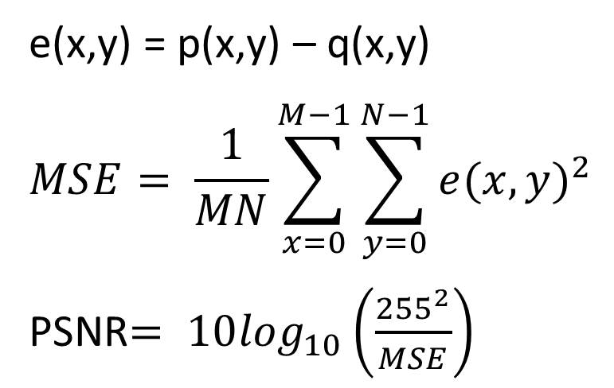
Space saving, Ss = 1 – 1/Cr
Compression gain, Cg = 10 log(Cr) dB
The two most commonly used distortion measures in image compression are: mean square error (MSE), and peak signal to noise ratio (PSNR).
e(x,y) = p(x,y) – q(x,y)
$$MSE= \frac{1}{MN}\sum_{x=0}^{M−1}{\sum_{y=0}^{N−1}{{e(x,y)}^{2}}}$$
PSNR$= 10\log_{10}\left(\frac{{255}^{2}}{MSE}\right)$
Notes:
You can see that the compression ratio, CR get bigger, the size of the compressed pictures get smaller
For CR=1 not compression at all, the picture size is 769 kilo bytes
And CR=76.9, the size compressed picture size is 10 kilo bytes. Using human eyes, we cannot really tell the difference.

Slide 32
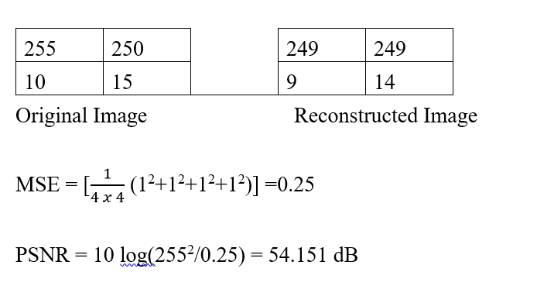
PSNR & MSE
Notes:
Given two images, one original and the other reconstructed, with their pixels value, we can use the formulae to calculate the Mean Square error – the smaller the better and also the Peak Signal to noise ratio – the larger the better.
Note that PSNR is in dB

Slide 33
Matlab immse command
Immse command can also be used to calculate the mean-squared error.
Example
Original Image, A
Quality, 100, B
>> MeanSquareError=immse(A,B)
MeanSquareError = 114.8493
Notes:
err = immse(X,Y) calculates the mean-squared error (MSE) between the arrays X and Y. X and Y can be arrays of any dimension, but must be of the same size and class.
As the compression ratio increase , mean square error increase and vice versa.
You can out in the lab session for MSE and PSNR between 2 rgb images A and B
MeanSquareError=immse(A,B)
PeakSignaltoNoiseRatio = psnr(A,B)
PeakSignaltoNoiseRatio = 27.5295 dB for the above picture)
As CR reduces, psnr increases

Slide 34
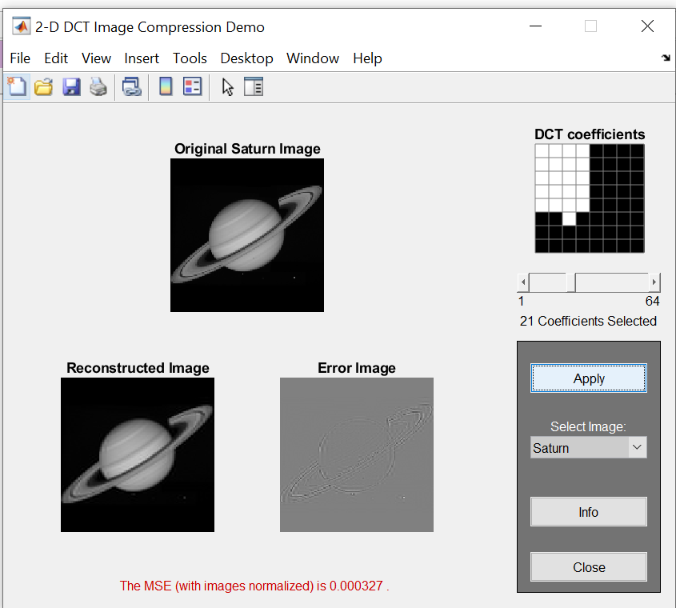
DCTDEMO.m
Figure 9.2 DCTDEMO
Notes:
This is a Matlab demo program DCTDEMO.m available for you to explore on the DCT concepts

Slide 35
Topic 2
Define lossless and lossy compressions/methods and the different classification of lossless classifications.
Notes:
In this topic 2, we are going to define and understand what is lossless compression and what is lossy compression and the different methods to do lossless compression and the techniques required to do lossy compression.
We will also look into the different classification of lossless classifications.

Slide 36
Two major classifications of Data Compression
1. Lossless Compression (Reversible Compression)
2. Lossy Compression (Irreversible Compression)
Notes:
There are 2 classifications of data compression: lossless and lossy
Lossless compression does not reduce the quality of the file. No data is lost, so lossless compression allows a file to be recreated exactly as it was when originally created and we term it reversible compression.
Lossless methods are used when we cannot afford to lose any data: legal and medical documents, computer programs.
Zip files are an example of lossless compression and we do not really get quite a high compression ratio, CR
Lossy compression removes some of a file’s original data in order to reduce the file size. In the process, this result in a small loss of quality of an image or sound file.
One popular lossy compression method for images is the JPEG, which is why most images on the internet are JPEG images.
JPEG: compress pictures and graphics
MPEG: compress video
MP3: compress audio
Another popular lossy compression method for sounds is MP3.
Once a file has been compressed using lossy compression, the discarded data cannot be retrieved again. Hence, it is termed irreversible.

Slide 37
Lossless Compression Techniques (Information Preserved, Low Cr)
Run Length Coding, RLC
Arithmetic Coding, AC
Lempel-Ziv-Welch, LZW
Notes:
Huffman maps fixed length symbols to variable length codes in the previous chapter.
Arithmetic maps entire message to real number range based on statistics. Theoretically optimal for long messages, but optimality depends on data model. Also can be CPU/memory intensive.
Lempel-Ziv-Welch is a dictionary-based compression method. It maps a variable number of symbols to a fixed length code.
The rest mentioned in other parts of slides

Slide 38
Lossy Compression
Lossy compression aims to obtain the best possible fidelity for a given bit-rate or minimizing the bit-rate to achieve a given fidelity measure. Video and audio compression techniques are most suited to this form of compression.
Lossy compression use source encoding techniques that may involve transform encoding, differential encoding or vector quantization.
Two of the most important organizations that are responsible for the Multimedia compression standards:
ITU International Telecommunication Union
ISO International Organization for Standardization
Notes:
Lossy compression aims to obtain the best possible fidelity for a given bit-rate or minimizing the bit-rate to achieve a given fidelity measure. Video and audio compression techniques are most suited to this form of compression.
Lossy compression use source encoding techniques that may involve transform encoding, differential encoding or vector quantization.
Two of the most important organizations that are responsible for the Multimedia compression standards:
ITU International Telecommunication Union
ISO International Organization for Standardization

Slide 39
Lossy Compression Techniques (Some Information lost, High Cr)
JPEG, Joint Photographic Experts Group
MPEG, Moving Picture Experts Group
Notes:
JPEG is the Joint Photographic Expert Group, which works on the standards for compression of still digital images.
MPEG is the Moving Picture Expert Group, which works on the standards for compression of digital movies

Slide 40
Lossless Compression Methods
Run-length Coding, RLC
The idea of Run-length coding is to replace consecutively repeated symbols in a source with a code pair which consists of either the repeating symbol or the number of its occurrences, or sequence of non-repeating symbols.
Example
Original Data: 00000001111111111000000011111
Compressed Data: (7,0), (1,10), (0,7),( 1,5)
Notes:
Run-length Algorithm/Encoding is frequently applied to images (or pixels in a scan line).
It is a small compression component used in JPEG compression.
Practically what is does is to replace the number of occurrences with the numeric value and the symbol itself. For example, a text like ‘AAAACBBBBB’ is efficient when there are only two symbols.

Slide 41
Arithmetic Algorithm/Coding
In arithmetic coding a source ensemble is represented by an interval between 0 and 1 on the real number line, according to the probabilities of the occurrence of the intensities.
Each symbol of the ensemble narrows this interval. As the interval becomes smaller, the number of bits needed to specify it grows.
Arithmetic coding assumes an explicit probabilistic model of the source.
Notes:
In arithmetic coding a source ensemble is represented by an interval between 0 and 1 on the real number line, according to the probabilities of the occurrence of the intensities.
From implementation point of view, Huffman coding is easier than arithmetic coding as you will see later in the example.
Arithmetic algorithm has a much more compression ratio than Huffman algorithm while Huffman coding needs less execution time than the arithmetic coding.

Slide 42
Example: The source of information A generates the symbols {a, b, c and d} with the corresponding probabilities {0.4, 0.3, 0.2 and 0.1}. The message to be encoded is” aadbc”.
Step 1
Source Symbol | Pi | Sub-interval
a | 0.4 | [0.0;0.4)
b | 0.3 | [0.4;0.7)
c | 0.2 | [0.7;0.9)
d | 0.1 | [0.9;1.0)
Notes:
Given the 4 symbols, a, b, c and d with their respective probabilities, 0.4, 0.3, 0.2 and 0.1.
The message to be encoded is” aadbc”.

Slide 43
Step 2
The first symbol to be encoded is a.
Source Symbol | New ‘a’ interval
A | [0.0;0.16)
B | [0.16;0.28)
C | [0.28;0.36)
d | [0.36;0.4)
Notes:
The step 2 shows the first symbol, a to be encoded

Slide 44
Step 3
The second symbol to be encoded is a.
Source symbol | New ‘a’ interval
A | [0.0;0.064)
B | [0.064;0.112)
C | [0.112;0.144)
d | [0.133;0.16)
Notes:
The step 3 shows the second symbol, a to be encoded

Slide 45
Step 4
The third symbol to be encoded is d.
Source Symbol | New ‘d’ interval
A | [0.144;0.1504)
B | [0.1504;0.1552)
C | [0.1552;0.1584)
→d | [0.1584;0.16)
Notes:
The step 4 shows the third symbol, d to be encoded

Slide 46
Step 5
The fourth symbol to be encoded is b
Source Symbol | New ‘d’’ interval
A | [0.144;0.1504)
→ B | [0.1504;0.1552)
C | [0.1552;0.1584)
d | [0.1584;0.16)
Notes:
The step 5 shows the fourth symbol, b to be encoded

Slide 47
Step 6
The final step for the fifth symbol to be encoded is C
Source Symbol | New ‘d’ interval
A | [0.1504;0.15232)
B | [0.15232;0.15376)
C | [0.15376;0.15372)
d | [0.15472;0.1552)
The number of symbols encoded will be stated in the protocol of the image format, so any number, such as 0.1543 within [0.15376, 0.15472) will be acceptable. The binary representation of this number is 0.001001111 which is 9 bits.
Notes:
Step 6 shows the fifth symbol, c to be encoded.
The binary representation of this number is 0.001001111 which is 9 bits.

Slide 48
Lempel-Ziv-Welch (LZW) Algorithm
LZW encoding is an example of a category of algorithms called dictionary-based encoding.
The idea is to create a dictionary (table) of strings used during the communication session.
The compression algorithm extracts the smallest substring that cannot be found in the dictionary from the remaining non-compressed string.
Notes:
This system does the encoding as two processes.
They are indexing and compressing a string of symbols.
When there is a set of characters, first step is to check whether an index have the minimum available character combination that appears. If available then put the index number in the string.
If not, it will be added to the index. This compression technique is more effective as it has a two way compression method.

Slide 49
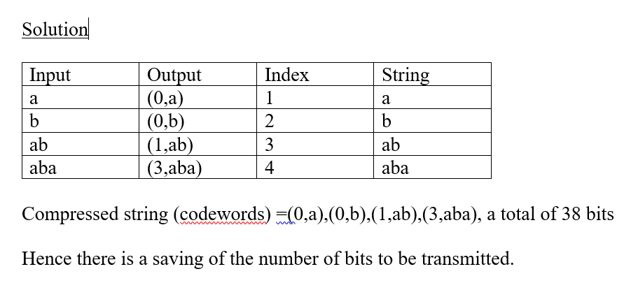
Given the input symbols is abababa
Notes:
Here the steps of the input symbols abababa and the steps are carried out according to the algorithm

Slide 50
Topic 3
Understand the constraints of multimedia on internet, wireless communication, and storage media like DVD and the different image and video formats.
Notes:
For topic 3, the constraints of multimedia on internet, wireless communication and storage media like DVD and others will be explored. We have explained that with larger file sizes, it will required more transmission time. However, to reduce the file size using various compression techniques, it will require higher processing capabilities. These are some are some of the constraints and also bearing in mind that once lossy compression techniques are employed, the original data cannot be 100% be recovered.
In topic 4, we will look into the different image and video formats

Slide 51
Topic 4
Know the different standards for image and video compression, and what are text, image, video and audio compressions.
Notes:
For Topic 4, we will look into the different standards for image and video compression.
What are text, image, video and audio compressions methods

Slide 52
Different data compression standards for Continuous-Tone Still Images
Name | Description
JPEG | Joint Photographic Experts Group, JPEG standard for images of photographic quality based on lossy baseline coding systems. It uses quantized discrete cosine transforms (DCT) on image block, Huffman, and run length coding and is one of the most popular methods for compressing images on the Internet.
JPEG-LS | A lossless to near-lossless standard for continuous-tone images.
JPEG-2000 | Arithmetic coding and quantized discrete wavelet transform (DWT) are used. The compression can be lossy or lossless.
Notes:
ISO/IEC working group is responsible for the JPEG standard that involves the compression of pictures and graphics.
Two common standards
H261, H263, H264
MPEG1(VCD), MPEG2(DVD), MPEG4
Spatial Redundancy: JPEG
Intraframe compression
Discrete Cosine Transform, DCT compression plus Huffman coding

Slide 53
Internationally sanctioned video compression standards
Name | Description
MPEG-1 | Audio/video standards designed for digital storage media (such as an MP3 file).
MPEG-2 | Standards for digital television and DVD video. Higher data rates for high-quality video
MPEG-4 | Multimedia standards for the computers, mobile devices, and the web
MPEG-7 | Standards for the description and search of multimedia content
Notes:
The Moving Picture Experts Group (MPEG) is the family of standards and file formats which are used in digital video.
MPEG was developed by the working group formed by IEC and ISO, which is also known as moving picture experts group. Because of the various sophisticated compression techniques used, MPEGs, when compared to most audio and video formats, are smaller in size and more or less of same quality.
MPEG-1 is the grandfather of the MPEG coder-decoder and is used to refer to both ends of the squeezing video down and expanding it to a viewable format again on playback.
MP3 is also known as MPEG-1 Audio Layer 3. MP3 originally came on the scene in 1993, making waves for reducing the size of an audio file down to about 10% of uncompressed size.
MPEG-2 is probably the most popular and standards for digital television and DVD videos in the twenty century.
Moving Pictures Experts Group
ISO/IEC working group, 1988
Standards for digital audio and video formats
Each compression standard designed with specific application and bit rate in mind.
Some examples:
MPEG1 – CD/WWW, Moving pictures and audio
MPEG2 – DVD/Digital TV, Moving pictures and audio
MPEG4 - Internet/Intranet, Multimedia
MPEG7 – Multimedia database
MPEG 1 – 30Mbps (Compressed 1.5 Mbps)
MPEG 2 – 128 Mbps (C 3-10 Mbps)

Slide 54
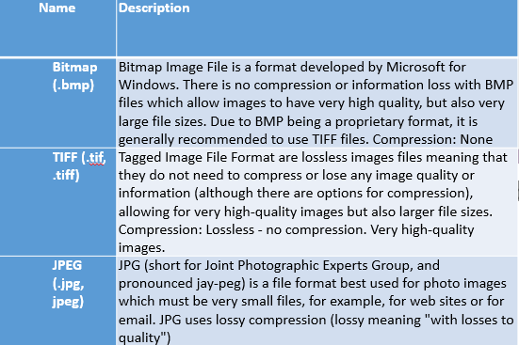
Popular image and video compression standards & file formats
Notes:
These are some of the popular image format used in hand phone, internet and computer.
There are others such as PNG (Portable Network Graphics) DICOM (Digital Imaging and COMmunication)

Slide 55
Discrete Cosine Transform, DCT
In 1974, the Discrete Cosine Transform was developed by Ahmed, Natrajan and Rao.
DCT is a core compression technology for JPEG (Joint Photo-graphic Experts Group) for still-image compression and MPEG (Motion Picture Experts Group) for video compression with compression ratio more than 15.
The principle of the DCT is to transform the original image pixels to an identical number of DCT coefﬁcients.
The DCT coefﬁcients have a nonuniform distribution of DC terms representing the average values, and AC terms representing ﬂuctuations.
The coefficients with zero frequency is called the “DC coefficient” and the remaining 63 coefficients are called the “AC coefficients.
Notes:
The role of the DCT is to decompose the original signal into its DC and AC components; the role of the IDCT is to reconstruct (re-compose) the signal.
Used in JPEG and the MPEG, H.261, and H.263 video compression algorithms, DCT techniques allow images to be represented in the frequency rather then time domain. Images can be represented in the frequency domain using less information than in the time domain.
A mathematical transform that can be perfectly undone and which is useful in image compression.
Many encoders perform a DCT on an eight-by-eight block of image data as the first step in the image compression process. The DCT converts the video data from the time domain into the frequency domain. The DCT takes each block, which is a 64-point discrete signal, and breaks it into 64 basis signals. The output of the operation is a set of 64 basis-signal amplitudes, called DCT coefficients. These coefficients are unique for each input signal. The DCT provides a basis for compression because most of the coefficients for a block will be zero (or close to zero) and do not need to be encoded
The compression is achieved by applying the advantages of encoding DC terms (with a large dynamic range) with a large number of bits and low-frequency AC terms (a few, with a reduced dynamic range) with a reduced number of bits, and neglecting some high-frequency AC terms that have small dynamic ranges (most of them do not affect the visual quality of the picture).

Slide 56
JPEG Compression
JPEG compression uses the 2D-DCT transform for both grayscale and color images in the YIQ color space.
JPEG uses different quality factors to normalize DCT coefﬁcients for the luminance(Y) channel and the chrominance (IQ) channels.
Notes:
JPEG compression uses the 2D-DCT transform for both grayscale and color images in the YIQ color space.
We will just mention but not covered YIQ color space.
JPEG uses different quality factors to normalize DCT coefﬁcients for the luminance(Y) channel and the chrominance (IQ) channels.

Slide 57
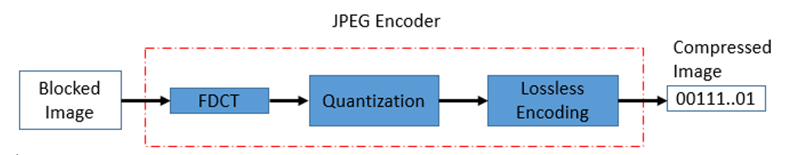
JPEG (Joint Photographic Experts Groups)
Figure 9.2 JPEG Encoder
Notes:
JPEG encoder is shown. The first block is the Discrete Cosine Transform, DCT followed by quantization and the lossless encoding

Slide 58
4 Important building blocks of JPEG
Image/Block Preparation - Partitioning of input images into 8x8 sub-block of pixels.
Forward Discrete Cosine Transform, FDCT - Perform FDCT which lays the foundation for achieving data compression by concentrating most of the signal in the lower spatial frequencies. The coefficient with zero frequency in both dimensions is called the “DC coefficient: and the remaining 63 coefficients are called the “AC coefficients”.
Quantization– quantized using uniform quantization tables based upon psych visual experiments.
Entropy Encoding - Zigzag – the scan is based upon that most of the high-frequency coefficients are zero. Encoding – uses Run length coding to generate intermediate sequence, and then Huffman coded for transmission or storage.
Notes:
4 major building blocks
Image/Block Preparation - Partitioning of input images into 8x8 sub-block of pixels.
Forward Discrete Cosine Transform, FDCT - Perform FDCT which lays the foundation for achieving data compression by concentrating most of the signal in the lower spatial frequencies. The coefficient with zero frequency in both dimensions is called the “DC coefficient: and the remaining 63 coefficients are called the “AC coefficients”.
Quantization– quantized using uniform quantization tables based upon psych visual experiments. This is the part that is responsible for the high compression ratio and it is irreversible portion. Quantization divides the number of bits by a constant, then drops the fraction. This is done to optimize the number of bits and the number of 0s for each particular application.
Entropy or lossless Encoding - Zigzag – the scan is based upon that most of the high-frequency coefficients are zero. Encoding – uses Run length coding to generate intermediate sequence, and then Huffman coded for transmission or storage.

Slide 59
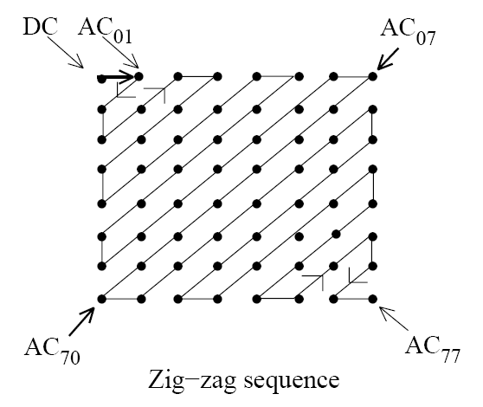
Zig-Zag Sequence
Horizontal Frequency
Vertical Frequency
Efficient encoding of the position of non-zero transform coefficients: zig-zag-scan + run-level-coding
Figure 9.4 Zig-Zag Sequence
Notes:
Zig –Zag sequence
Efficient encoding of the position of non-zero transform coefficients: zig-zag-scan plus run-level-coding

Slide 60
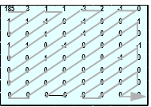
Original 8x8
block
DCT
Transformed 8x8 block
Q
Zig-zag scan
Figure 9.4a – Tranform, ZigZag & Run-Length Coding
(0,3) (0,1) (1,1) (0,1) (0,1) ..) (1,-1) (14,1) (9,-1) (0,-1) EOB
Run-length coding (RLC)
Notes:
The block diagram showing the process of the original 8x8 block to the Run-length coding

Slide 61
2-D JPEG Grayscale Image Compression
DCT coefficients have a big DC component but small AC components values.
These coefficients are further normalized (quantized) with a quality factor Q where the DC coefficient is further reduced slightly but the AC coefficients much more leaving a few AC coefficients.
Encode and transmit only nonzero DCT coefficients and omit transmitting zeros, hence DATA COMPRESSION!
Notes:
This is the 3 steps for 2 dimensional JPEG grayscale compression

Slide 62
JPEG Colour Image Compression
Transform RGB to YCbCr.
Real-time images and videos are stored in RGB color space, because it is based on the sensitivity of color detection cells in the human visual system.
In digital image processing the YCbCr color space is often used in order to take advantage of the lower resolution capability of the human visual system for color with respect to luminosity.
RGB to YCbCr conversion is widely used in image and video processing .
Notes:
A little bit more complication for the JPEG colour image compression to do the transformation from RGB to UCbCR for a purpose.

Slide 63
JPEG Colour Image Compression
Perform DCT on blocks.
Perform Quantization.
Perform ZigZag ordering or scanning, DPCM (Differential Pulse-code modulation) for DC coefficients and Run-Length Coding, RLC on AC coefficients.
Perform Huffman coding.
Notes:
Similar processes such as performing DCT, quantization, zigzag ordering and Huffman coding

Slide 64
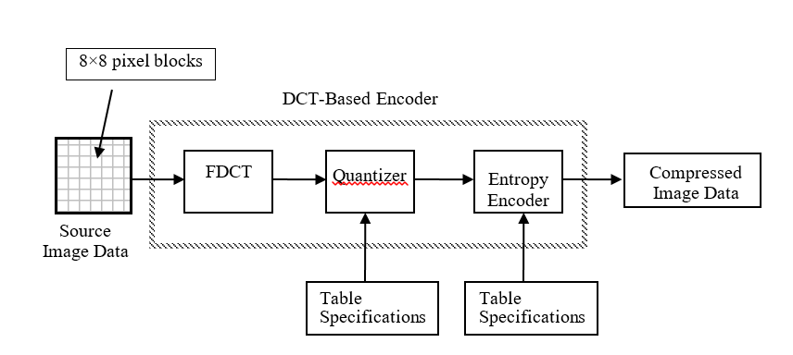
DCT Encoder-Based Processing Step
Figure 9.5 DCT Encoder-Based Processing Step
Notes:
Here we include the Table specifications for both the quantizer and entropy or lossless encoder

Slide 65
DCT One-Dimensional - MP3
The DCT transforms the spatial signal to frequency domain coefficients.
No complex number operations (Discrete Fourier Transform)
DCT decomposes a block of data
DC coefficient ->average of the data samples
AC coefficients , each corresponding to the frequency components.
Notes:
Similar processes for MP3

Slide 66
Digital Audio Compression
A simple and widely used audio compression method is Adaptive Delta Pulse Code Modulation (ADPCM).
MPEG Audio Compression besides video standards
MPEG-1 (1991) CD quality audio
MPEG-2 (1994) Multi-channel surround sound
MPEG-4 (1998) MIDI, speech etc
MPEG-1 defined three downward compatible layers of audio compression
For our case, we will only touch on layer 3 - music (MPEG-1 layer 3 == mp3)
Notes:
Digital Audio compression is a huge topic.
A simple and widely used audio compression method is Adaptive Delta Pulse Code Modulation (ADPCM). In ADPCM, the dynamics in real audio signals, we have quiet periods and low periods. In quiet periods where there is low variance of the amplitude, we can encode the signal with fewer bits than in loud period.
Audio compression can based on sematic irrelevance. It means that we remove those parts of the signal at the source that the receiver will not be able to hear anyway.
Without going into too much detail, the followings are other audio compression standards.
MPEG stands for Moving Picture Experts Group. It is a committee of ISO, International Organization for Standardization where the development and publication of International Standards.
MPEG Audio Compression besides video standards
MPEG-1 (1991) CD quality audio
The goal of MPEG-1 is to compress a video signal (with audio) to a data stream of 1.5 Mbit per second.
MPEG-2 (1994) Multi-channel surround sound
MPEG-4 (1998) MIDI, speech etc
MPEG-1 defined three downward compatible layers of audio compression
For our case, we will only touch on layer 3 - music (MPEG-1 layer 3 == mp3)

Slide 67
One-Dimensional (1D) DCT, 1D-DCT
DCT(Forward Transform) for N data samples
IDCT(Inverse transform)
Notes:
A lot have been shown in the previous many slides, DCT, Discrete Cosine Transform
We will look into one dimensional DCT.
The formula is shown in the slide

Slide 68
Example
x(n)={10,8,10,12} where N=4
X_{DCT}(0) = 20, X_{DCT}(1) = -1.8478, X_{DCT}(2) = 2, X_{DCT}(3) = 0.7654
Using Matlab,
>> dct([10 8 10 12])
ans =
20.0000 -1.8478 2.0000 0.7654
We can quantize the DCT coefficients and encode them into binary data. 1D-DCT can be used to audio coding. A modified DCT is used in MPEG-1 MP3 audio coding.
Similarly, 2D-DCT can be used for JPEG image compression.
Notes:
Using the formula, we can transform the discrete time signal, x n into the equivalent form X DCT coefficients using the formula
Or using Matlab command
What do you think the values of X DCT if the coefficients of x n are the same?

Slide 69
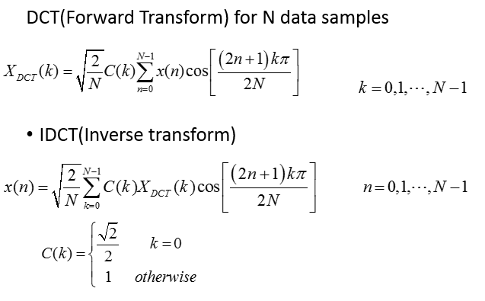
x(n) – sample in discrete time domain
Xdct(k) – dct coefficients in the frequency domain
Notes:
Small cap, x – discrete time , time domain
Big cap, X – frequency domain

Slide 70
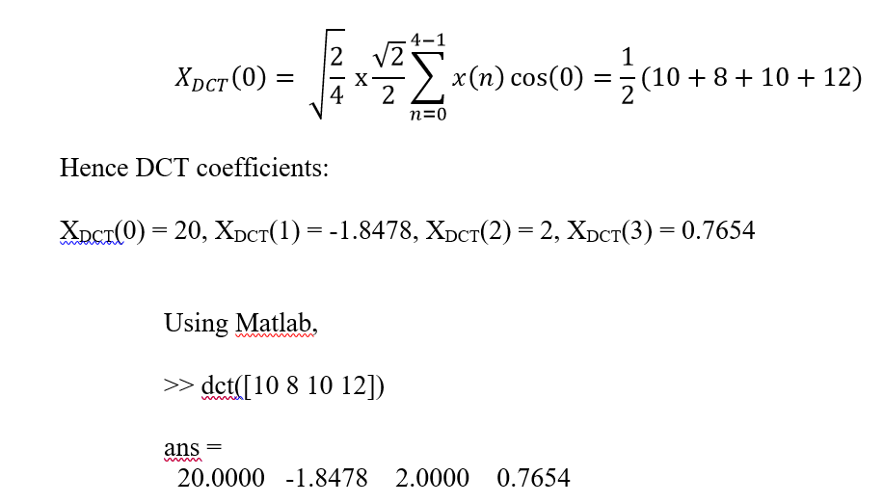
Samples: x(n)={10,8,10,12} where N=4
Note x(0)=10, x(1)=8, x(10), x(12), N=4

Slide 71
Two-Dimensional (2D) DCT
Forward DCT
Inverse DCT
p(I,j) = pixel level at the location (i,j)
F(u,v) =DCT coefﬁcient at the frequency indices (u,v)
Notes:
Two dimensional DCT and its formulae

Slide 72
DCT – Revised
The DCT transformation creates table p(i,j) from table F(u,v).
The DC value gives the average value of the pixels.
The AC values gives the changes.
Lack of changes in neighboring pixels creates 0s.
The DCT transformation is reversible.
Mathematical formula for DCT transformation – complex and required practice.
Notes:
There are many other Transform methods such as Wavelet transform which is more advanced.
We have shown a short summary of the DCT here

Slide 73
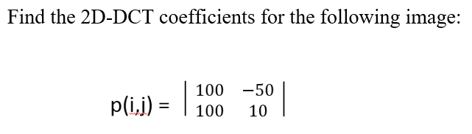
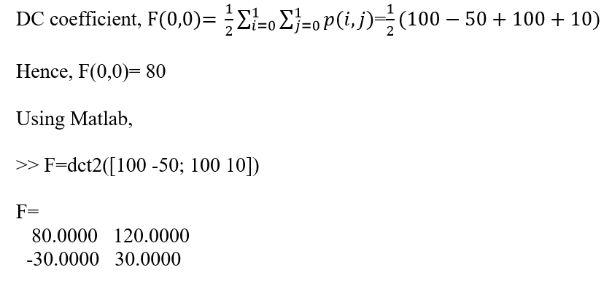
Notes:
Here Matlab can help us to calculate the coefficients quite easily

Slide 74
Video compression—MPEG -2
In a motion sequence, individual frames of pictures are grouped together (called a group of pictures, or GOP) .
MPEG method first divides frames into three categories: I-frames, P-frames, B-frames.
An I‑frame (Intra-coded picture or key frame), a complete image, like a JPG or BMP image file.
P (Predicted Picture) and B (Bi-directionally predicted pictures) frames hold only part of the image information (the part that changes between frames), so they need less space in the output file than an I‑frame.
Notes:
There are four types of MPEG frames.
Intra-frame (I-frame) – Intra-coded full image, very similar to the JPEG image, encoded with Discrete Cosine Transform, DCT, quantization, run-length coding and Huffman coding. I-pictures are compressed independently (similar to JPEG images). This means they're ideal when the image changes a lot, but take up a lot of bits. So if you use too many I-pictures, you will need an overall higher bitrate to keep the quality up.
Predicted frame (P-frame) uses delta encoding. The P frame refers to preceding I and P-frames.
B-frame (Interpolated or bidirectional frame, bidirectional predictive coded pictures. The B frames refers to proceeding and succeeding frames, interpolated the data and encoded the differences.
D-frame is the DC code picture, only the DC coefficient of each block is coded for previews.

Slide 75




Intraframe compression, when applied to image sequences, reduces only the spatial redundancies present in an image sequence. Interframe compression employs temporal predictions and thus aims to reduce temporal as well as spatial redundancies, increasing the efficiency of data compression.
I₁ B₁ B₂ P₁ B₃ B₄ P₂ B₅ B₆ P₃ B₇ B₈ I₂
Notes:
To repeat
I-frame is as known as a keyframe, this is a full frame image of the video.
P-frame is known as predictive frame, this is a delta frame that only contains some of the image. It will look backwards toward an i-frame or another p-frame to see if part of the image is the same. If so, that portion will be excluded to save space.
B-frame is known as bi-directional predictive frame, this is a delta frame that also only contains some of the image. The difference between this and a p-frame, though, is that it can look backwards or forwards for other delta frames or i-frames when choosing what details to leave out as they exist in another frame. As a result, b-frames offer improved compression without detracting from the viewing experience.

Slide 76
Video compression--MPEG
Spatial compression
The spatial compression of each frame is done with JPEG.
Spectral redundancy is due to correlation between different color planes.
Temporal compression
The temporal compression removes the redundant frames.
Basic idea:
Each video is a rapid sequence of a set of frames. Each frame is a spatial combination of pixels, or a picture.
Compressing video =
spatially compressing each frame
+
temporally compressing a set of frames.
Notes:
MPEG is also a Lossy Compression technique. It is a way to encode the moving images and audio included in it.
Redundancy refers to the amount of wasted space consumed by storage media to record picture information in a digital image.
Image compression is achieved by exploiting redundancies in the image. These redundancies could be spatial, spectral, or temporal redundancy.
Spatial redundancy: elements that are duplicated within a structure, such as neighboring pixels in a still image. Exploiting spatial redundancy is how compression is performed.
Spectral redundancy is due to correlation between different color planes.
Temporal redundancy: pixels in two video frames that have the same values in the same location. It is due to correlation between different frames in a sequence of images such as in videoconferencing applications in broadcast images.
For example, in a static scene in which someone is talking, most frames are the same except for the segment around the speaker’s lips, which changes from one frame to the next.
Exploiting temporal redundancy is one of the primary techniques in video compression.
The big picture is that Each video is a rapid sequence of a set of frames. Each frame is a spatial combination of pixels, or a picture. Compression video involved both spatial and temporal compressions.
It supports many video formats from mobile phone to HD TV.

Slide 77
MPEG compression
The use of a frequency-based transform called Discrete Cosine Transform (DCT).
Quantization, a technique for losing selective information (sometimes known as lossy compression) that can be acceptably lost from visual information.
Huffman coding, a technique of lossless compression that uses code tables based on statistics about the encoded data.
Motion compensated predictive coding, in which the differences in what has changed between an image and its preceding image are calculated and only the differences are encoded.
Bi-directional prediction, in which some images are predicted from the pictures immediately preceding and following the image.
Notes:
Here MPEG compression is an extension of JPEG compression and motion is involved.

Slide 78
MPEG Audio Compression, MPEG-1
Exploit areas where the human ear is less sensitive to sound to achieve compression.
MPEG audio compresses by removing acoustically irrelevant parts of audio signals
Dividing the audio signal up into a set of frequency sub bands.
Uses a bank of DCT-based or FFT-based (or even FIR/IIR) analyzer filters.
Perform quantization process.
Uses Huffman coding on quantized samples.
Notes:
MPEG Audio Compression, MPEG-1 exploit areas where the human ear is less sensitive to sound to achieve compression.
MPEG audio compresses by removing acoustically irrelevant parts of audio signals
Dividing the audio signal up into a set of frequency sub bands.
Uses a bank of DCT-based or FFT-based (or even FIR/IIR) analyzer filters.
And the rest such as quantization and Entropy coding follows.

Slide 79
Key Point
Transform compression, in this case DCT is change from one domain to another domain, in this case frequency.
In particular, the low frequency components of a signal are more important than the high frequency components.
Removing about 50% of the bits from the high frequency components might remove, may only affect 5% of the encoded information when decoded.
Notes:
We can see that DCT is a very useful technique in helping to achieve lossy data compression for both JPEG and MPEG.
There are also other transform method such as Wavelet and Discrete Karhunen-Loeve Transform (DKLT) which is not covered in this chapter.
The full details of JPEG and MPEG is not shown but the basic idea of how data compression for both JPEG and MPEG is indicated especially in the block diagram.
T

Slide 80
MPEG 2 Video Compression
Pictures are made up of pixels.
Each 8x8 array of pixels is known as a block.
A 2x2 array of blocks is termed a macroblock.
Pictures called I pictures are encoded without prediction. Pictures termed P pictures may be encoded with prediction from previous pictures. B pictures may be encoded using prediction from both previous and subsequent pictures.
Notes:
MPEG 2 Video Compression revisit

Slide 81
Quantization
After the F table is created, the values are quantized to reduce the number of bits needed for encoding.
Quantization:
Divide the number by a constant and then drop the fraction.
The quantizing phase is not reversible.
Some information will be lost.
Notes:
Quantization steps

Slide 82
Compression
After quantization, the values are read from the table, and redundant 0s are removed.
The reason is that if the picture does not have fine changes, the bottom right corner of the F table is all 0s.
Notes:
Removing the redundant 0s. This is the lossy portion

Slide 83
MPEG-4
Addresses speech and video synthesis, fractal geometry, computer visualization, and an artificial intelligence (AI) approach to reconstructing images.
Standard way for authors to create and define the media objects in a multimedia presentation, how these can be synchronized and related to each other in transmission, and how users are to be able to interact with the media objects.
Notes:
MPEG1 – up to 1.5Mbit/sec. CD-ROM Video Standards, Standard of compression for Video CD
MPEG2 – between 1.5 to 15 Mbit/sec. Digital Television set up boxes, DVD compression, ability to efficiently compressed interlaced video.
MPEG4 – standards for multimedia and Web compression.
It addresses speech and video synthesis, fractal geometry, computer visualization, and an artificial intelligence (AI) approach to reconstructing images

Slide 84
MPEG-7
MPEG-7 will be a standardized description of various types of multimedia information.
This description will be associated with the content itself, to allow fast and efficient searching for material that is of interest to the user. MPEG-7 is formally called “Multimedia Content Description Interface”.
https://en.wikipedia.org/wiki/MPEG-7
Notes:
MPEG-7 will be a standardized description of various types of multimedia information.

